Slide 1
Maximum likelihood: a bit of context

Slide 2
Outline
Step back – the bigger picture
From data to maximum likelihood estimation (and back again):
- Population and sample
- Model choice
- Parameter estimation
- Uncertainty
- Interpretation

Slide 3
Steps of modelling (week 2 recap)
Choose a model for your data
Get estimates of the parameters
Quantify uncertainty in the estimates
Interpret the results

Slide 4
Steps of modelling (week 2 recap)
Choose a model for your data
Get estimates of the parameters
Quantify uncertainty in the estimates
Interpret the results
Maximum likelihood

Slide 5
Schematic
Model
Data
Parameter estimation
Uncertainty
Notes:
Can think of all of these processes as linking together. Will cover each of these bits in more detail today and explain where maximum likelihood estimation fits in

Slide 6
Schematic
Model
Data
Parameter estimation
Uncertainty
Notes:
Begin with data

Slide 7
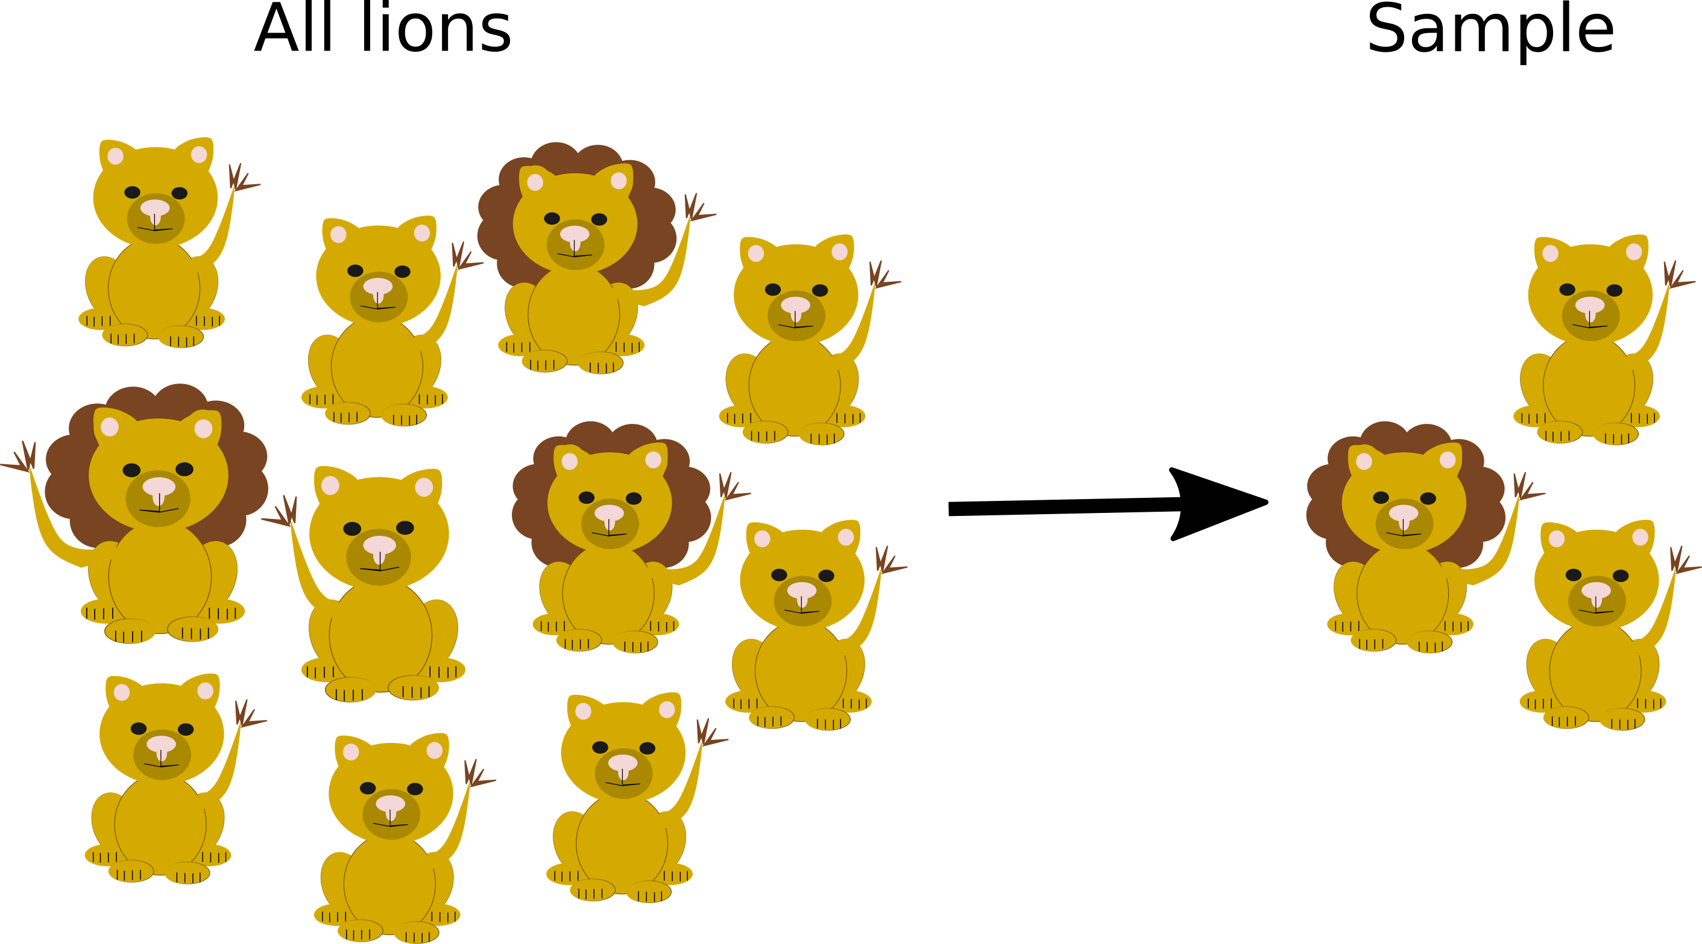
Data in statistical modelling
Example of lions
Notes:
Imagine a group of lions

Slide 8
Data in statistical modelling
Example of lions
Notes:
Imagine a group of lions

Slide 9
Data in statistical modelling
Notes:
We want to collect data on the lions. We cannot catch them all.

Slide 10
Data in statistical modelling
Notes:
In our sample, count number of lions in the pride

Slide 11
Data in statistical modelling
Notes:
In our sample, count number of lions in the pride

Slide 12
Data in statistical modelling
Count number of lions in prides (100 prides here)
Notes:
In our sample, count number of lions in the pride

Slide 13
Data in statistical modelling
Count number of lions in prides (100 prides here)
This becomes our data
Notes:
In our sample, count number of lions in the pride

Slide 14
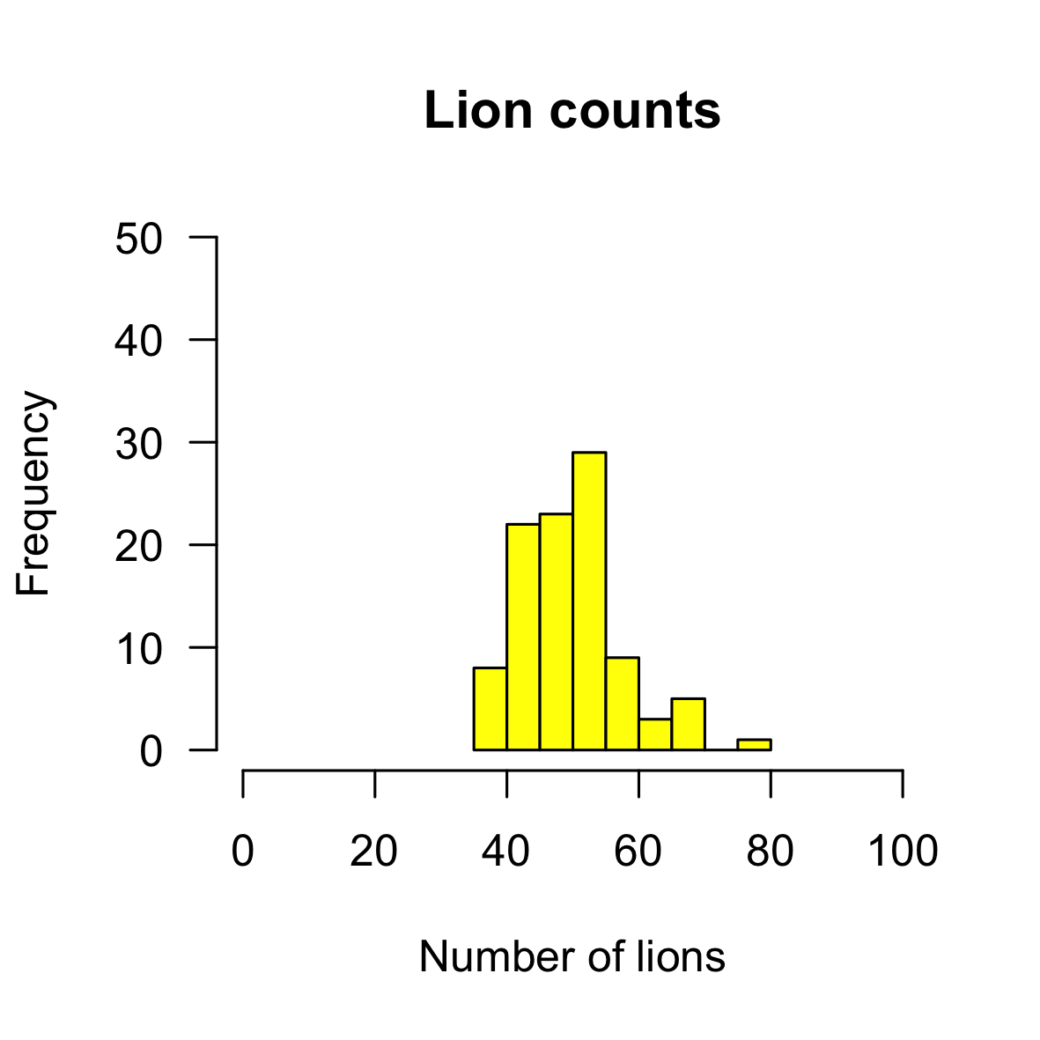
Data in statistical modelling
Count number of lions in prides (100 prides here)
This becomes our data
Notes:
In our sample, count number of lions in the pride

Slide 15
Data in statistical modelling
Want to say something about total population of lions
Need a model!
Notes:
We want to say something about the population because this is more interesting. We don’t want to only describe our sample (sometimes you do, but not often), we will have missed some lions in each pride and some whole prides. But we want to give an idea of the number of lions in each pride for all lions. Other examples = say something about all birds in a wood from sampling 100, say something about all trees in a woodland from sampling 50 etc.

Slide 16
Model
Data
Parameter estimation
Uncertainty
Notes:
Once we have data, want to choose a model

Slide 17
Choosing a model
Counts of numbers of lions
Cannot be below 0
Cannot have half lions (whole numbers only)
Notes:
We have our data and have plotted it for 100 prides. We need to find a model that can represent how these data were generated.

Slide 18
Choosing a model
Counts of numbers of lions
Cannot be below 0
Cannot have half lions (whole numbers only)
Poisson distribution
Notes:
A Poisson distribution fits this characteristics.

Slide 19
Choosing a model
Counts of numbers of lions
Cannot be below 0
Cannot have half lions (whole numbers only)
Poisson distribution
Notes:
You can see it follows a similar shape to our data too.

Slide 20
Any model
Our example = Poisson distribution

Slide 21
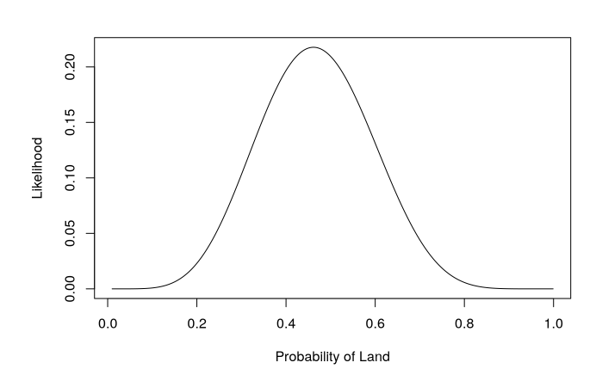

Any model
Our example = Poisson distribution
But works for any model
E.g. Binomial distribution (land and sea)
Notes:
The same process is true for other datasets and models

Slide 22
Any model
Our example = Poisson distribution
But works for any model
E.g. Binomial distribution (land and sea)
Linear equation (regression – coming soon)
Almost anything
Notes:
This is GENERAL idea

Slide 23
Model
Data
Parameter estimation
Uncertainty
Notes:
Now we have a model, need to estimate the parameters of the model

Slide 24
Parameter estimation
Notes:
Back to our data, we have these counts of lions and we have plotted them in a histogram

Slide 25
Parameter estimation
Poisson distribution
Notes:
We have also chosen our model

Slide 26
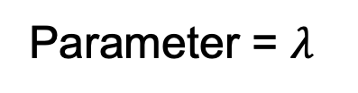
Parameter estimation
Parameter = $λ$
Poisson distribution
Notes:
We know that this is characterised by a single parameter lambda (mean and the variance)

Slide 27
Parameter estimation
Parameter = $λ$
Poisson distribution
Want to find the value of the parameter that is most likely to give rise to our observed data
Notes:
We want to estimate that parameter. We find the parameter which is most likely to give rise to our data

Slide 28
Parameter estimation
Parameter = $λ$
Poisson distribution
Maximum likelihood
Notes:
We want to estimate that parameter. We find the parameter which is most likely to give rise to our data

Slide 29
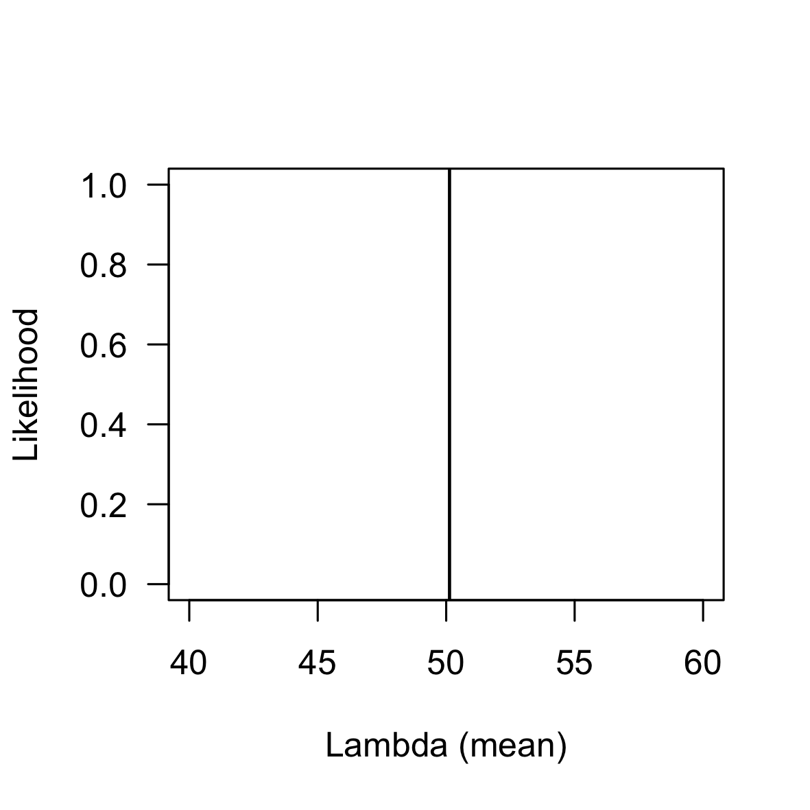
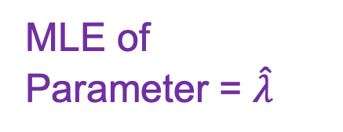
Parameter estimation
MLE of Parameter = $\hat{λ}$
50
Poisson distribution
Notes:
We use maximum likelihood estimation to get a maximum likelihood estimate of our parameter for this dataset

Slide 30
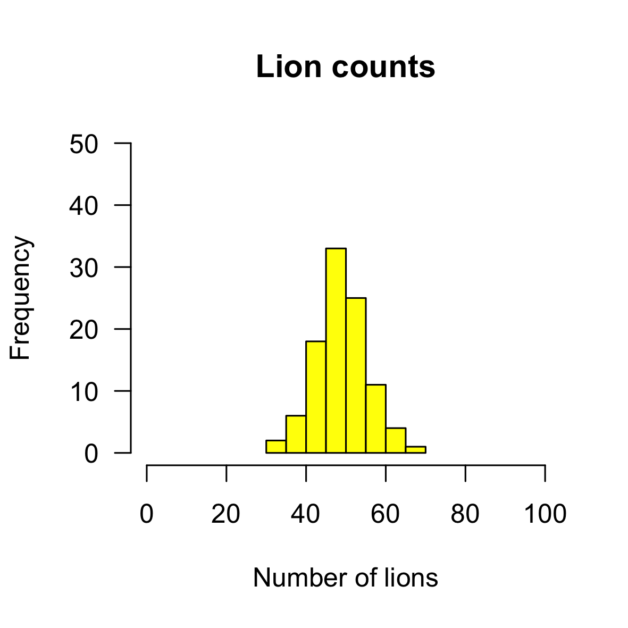
Parameter estimation
Poisson distribution
Notes:
If you repeat this again with a different sample.

Slide 31
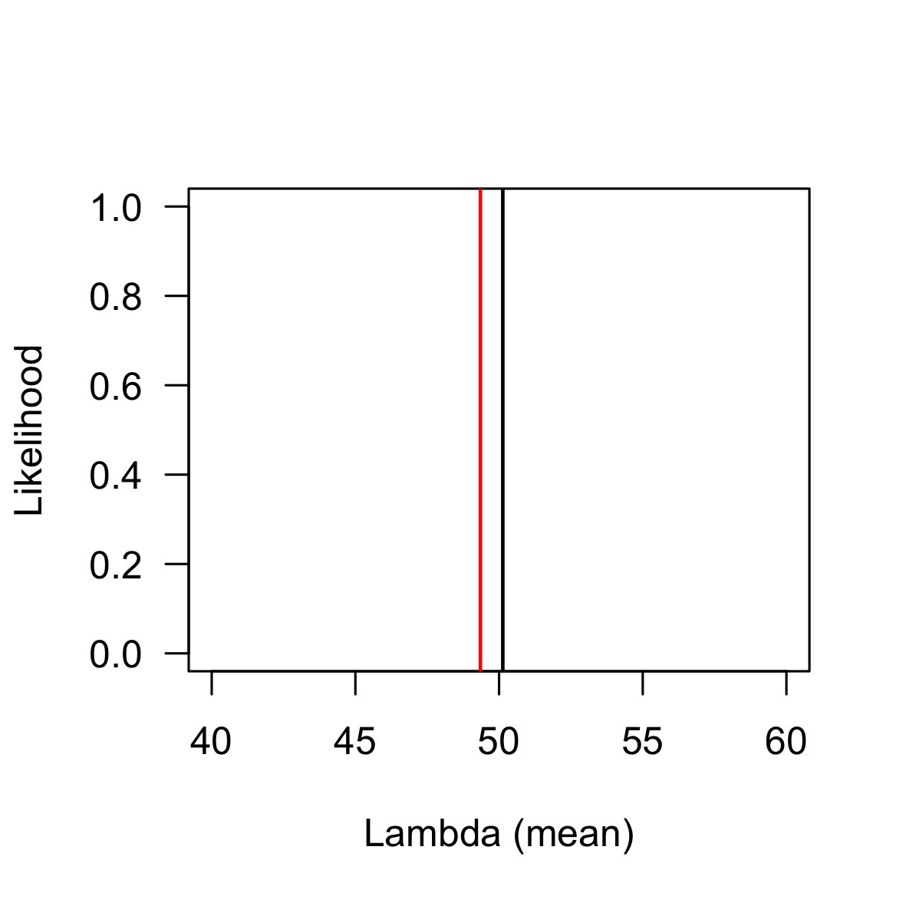
Parameter estimation
MLE of Parameter = $\hat{λ}$
49
Poisson distribution
Notes:
You will get a different estimate of the parameter in your model – because the likelihood is conditional on the data.

Slide 32

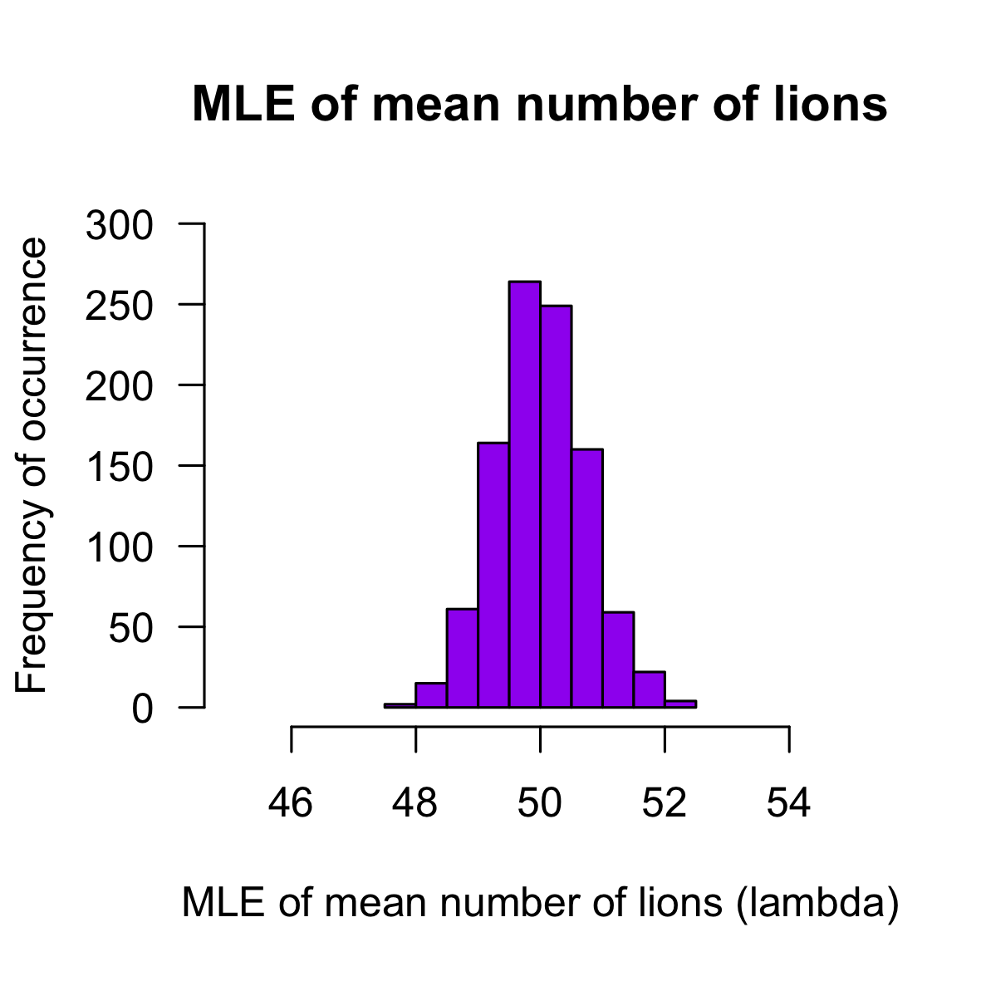
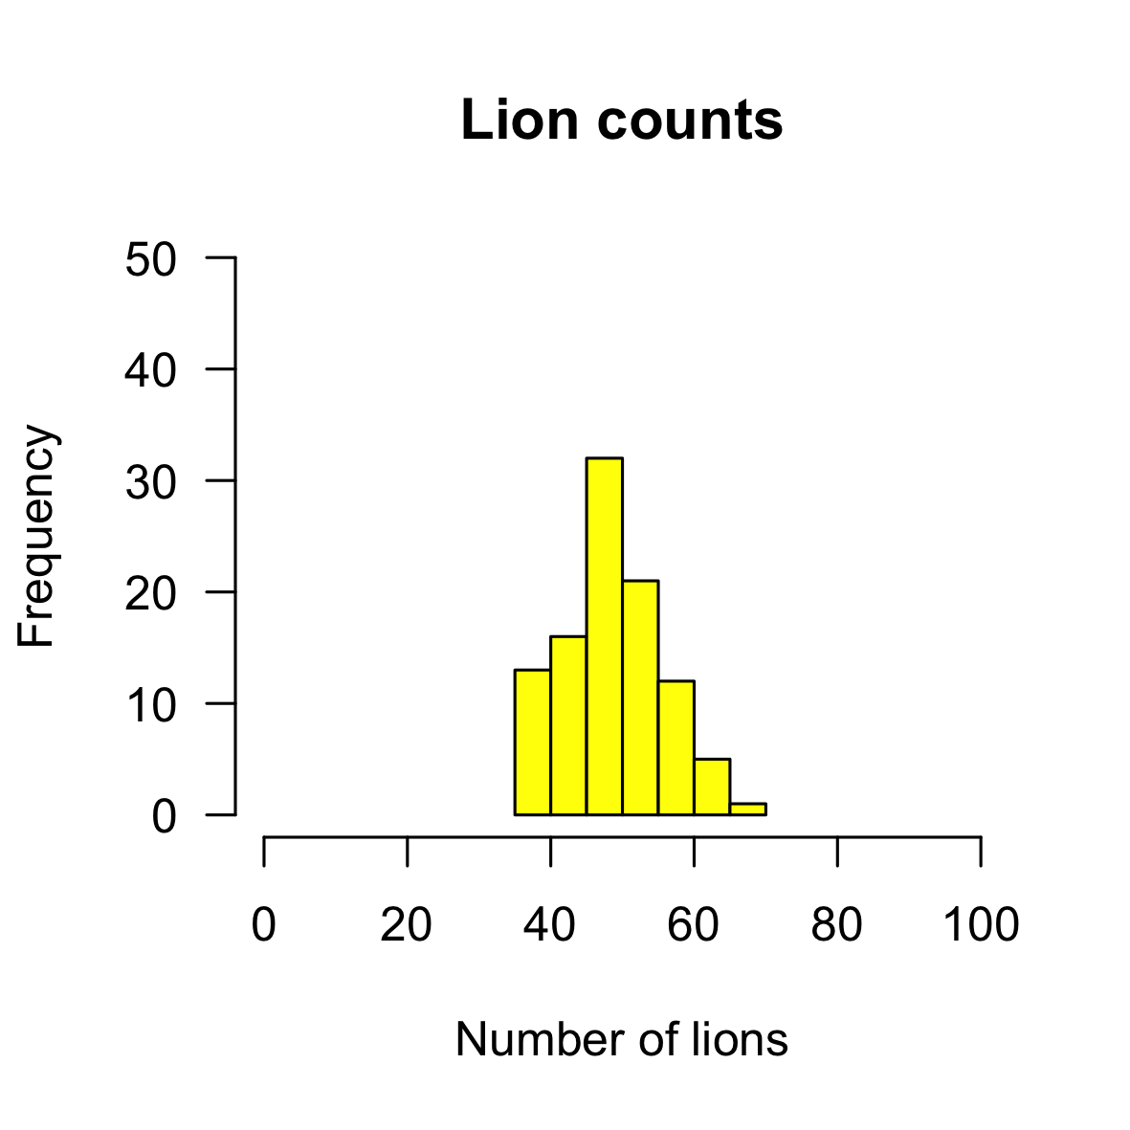

Parameter estimation
MLE of Parameter = $\hat{λ}$
Poisson distribution
Notes:
We use maximum likelihood estimation to get a maximum likelihood estimate of our parameter for this dataset

Slide 33
Parameter estimation
MLE of Parameter = $\hat{λ}$
Poisson distribution
Notes:
We use maximum likelihood estimation to get a maximum likelihood estimate of our parameter for this dataset

Slide 34

Distribution of $\hat{λ}$
Notes:
Here is the distribution of the estimates of the parameter. Can see out of 1000 samples, got around 50 about 260 times.

Slide 35
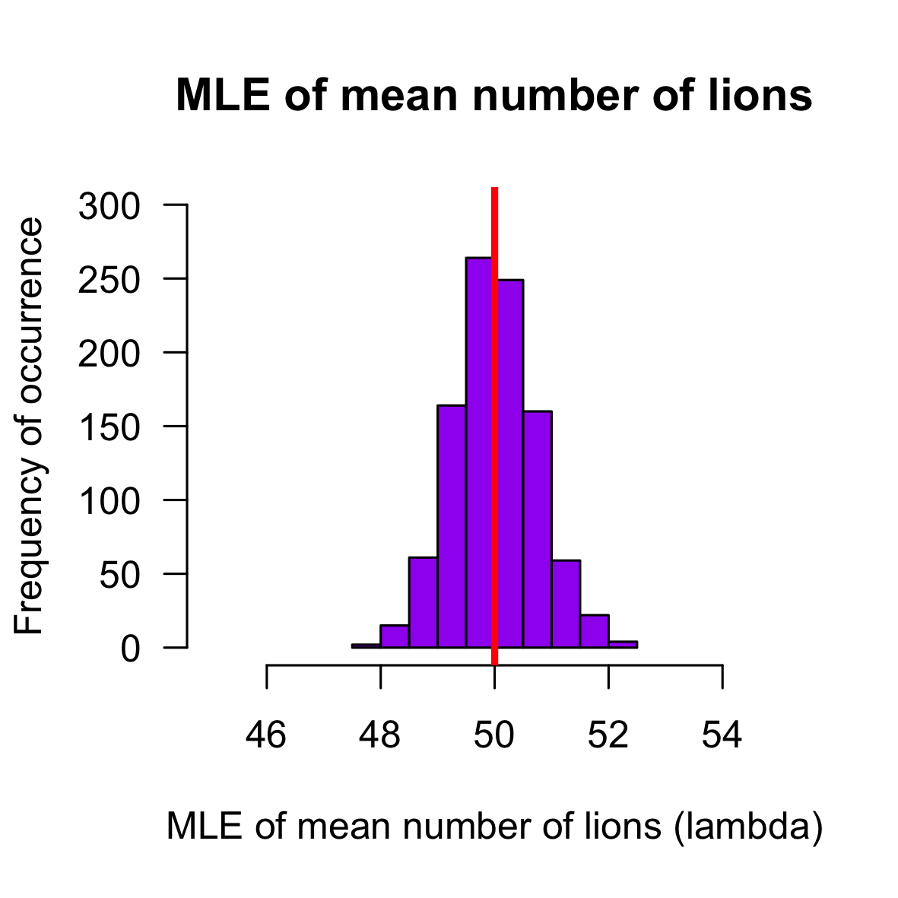

Distribution of $\hat{λ}$
$λ$ = 50
Notes:
The mean is actually the true population level value of lambda

Slide 36
Distribution of $\hat{λ}$
$λ$ = 50
Notes:
The mean is actually the true population level value of lambda

Slide 37

Distribution of $\hat{λ}$
$λ$ = 0.5
Needs lots of samples
Notes:
But to get this distribution requires a lot of simulation or many samples – this is rarely possible

Slide 38
Parameter estimation from a single sample
Notes:
We really want a way to get that distribution of possible estimates from a single sample

Slide 39
Parameter estimation from a single sample
We need to:
represent the distribution of the parameter mathematically
and based on our single sample of data
Notes:
We really want a way to get that distribution of possible estimates from a single sample

Slide 40
Parameter estimation from a single sample
We need to:
represent the distribution of the parameter mathematically
and based on our single sample of data
This is what we use the likelihood to do
Notes:
This is where the likelihood and maximum likelihood estimation come in.

Slide 41
Parameter estimation from a single sample
Notes:
From a single sample

Slide 42
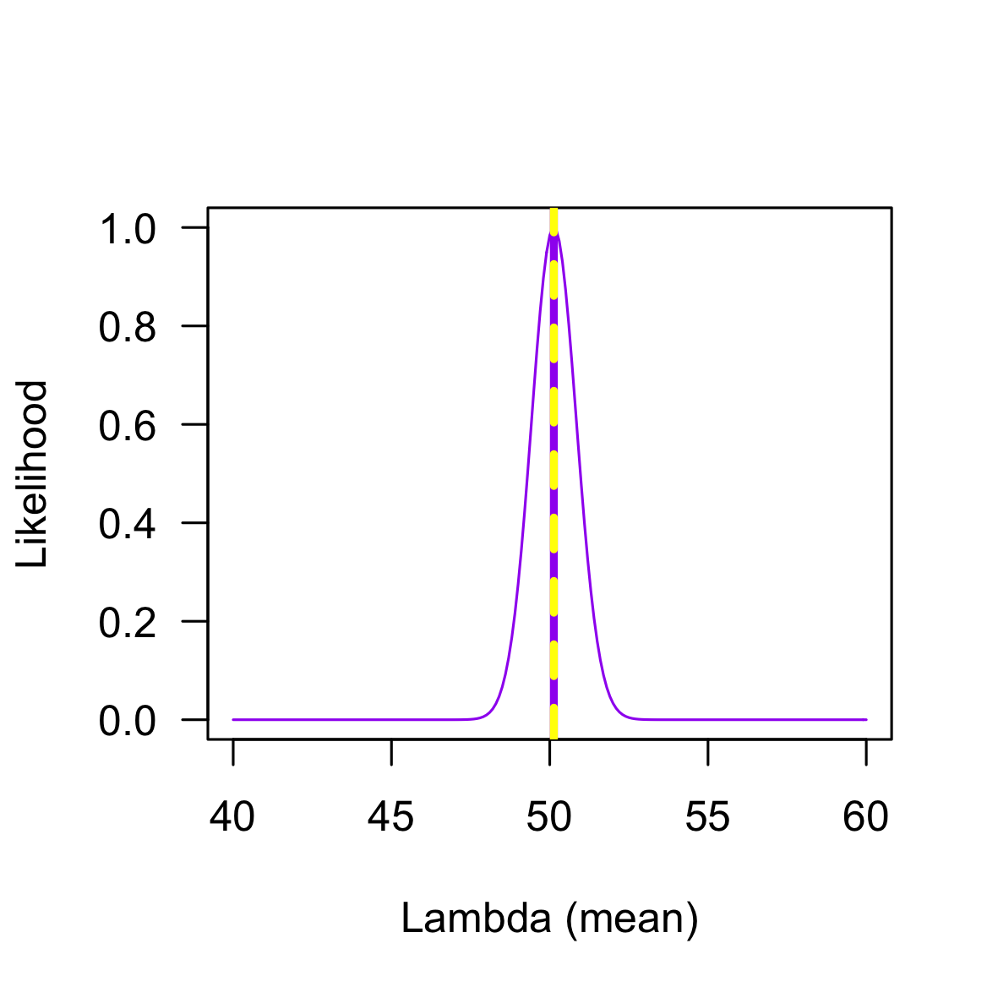
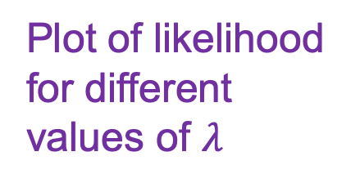
Parameter estimation from a single sample
Plot of likelihood for different values of $λ$
Notes:
We produce a likelihood curve based on that data, we find the probability of getting this sample based on different values of the parameter and find the one that makes it most likely. Here that is also the mean of our sample. You can see that the estimate is closely tied to the data.

Slide 43

Parameter estimation from a single sample
Plot of likelihood for different values of $λ$
$\hat{λ}$ = mean of the data

Slide 44

Parameter estimation from a single sample
$\hat{λ}$ = mean of the data
Notes:
The actual distribution you would get by taking many samples is NOT the same as the one you get from maximum likelihood estimation. This is because when we estimate, it is relative to our data, that is the only information we have. So always centred on our MLE of the parameter – but tries to represent it from limited information

Slide 45
Model
Data
Parameter estimation
Uncertainty
Notes:
So, the final part to consider is uncertainty

Slide 46
Model
Data
Parameter estimation
Uncertainty
Notes:
Actually it is influenced by everything else and is therefore really important!

Slide 47
Uncertainty
Notes:
We are now back to our likelihood curve we can see there is another component to this distribution as well as the maximum

Slide 48
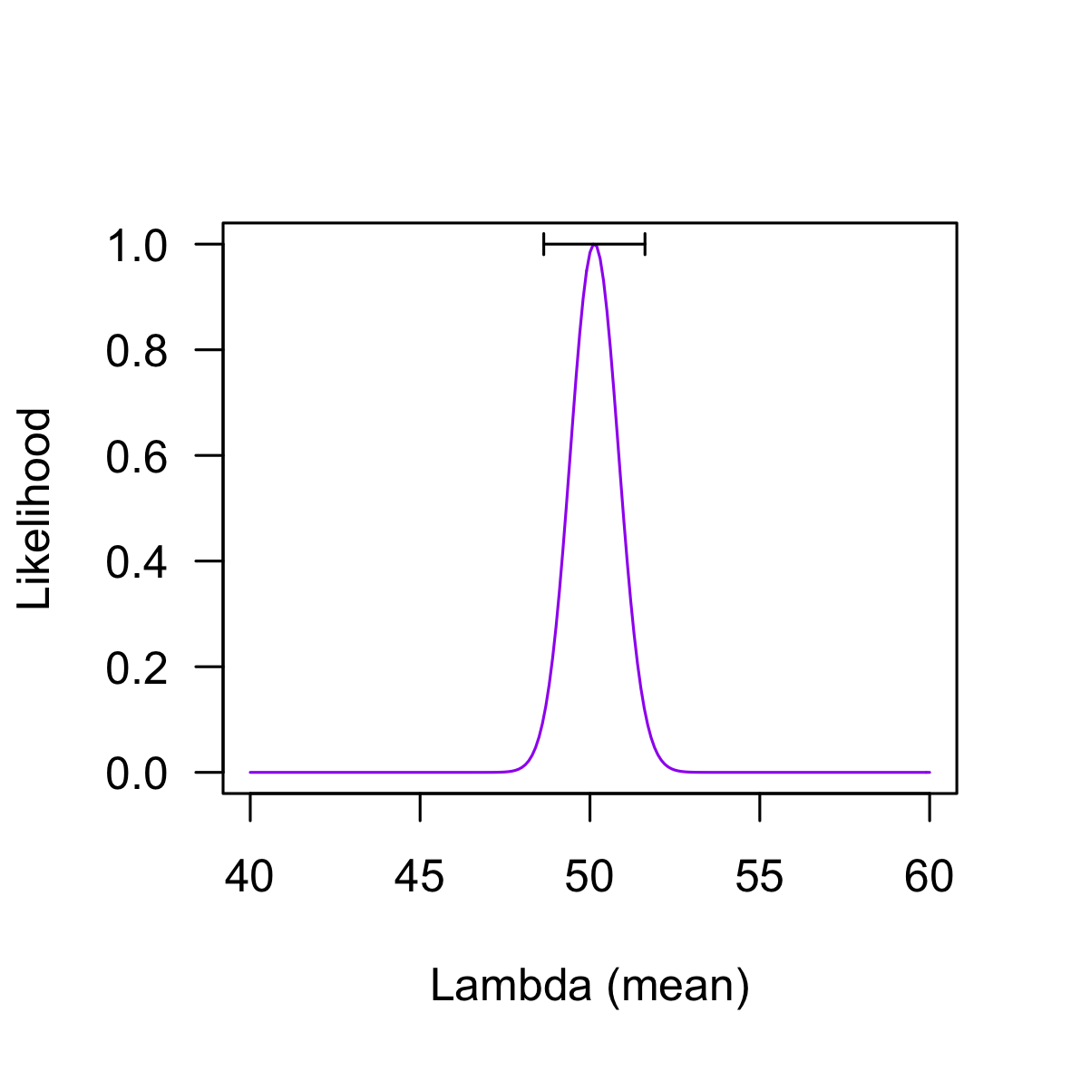
Uncertainty
Notes:
There is also a spread – this helps us to represent uncertainty in our estimate of the parameter

Slide 49
Uncertainty
How can we quantify it?
Notes:
We represent it using confidence intervals

Slide 50
Uncertainty
How can we quantify it?
Confidence intervals
Notes:
We represent it using confidence intervals – hopefully this is familiar from last week!

Slide 51
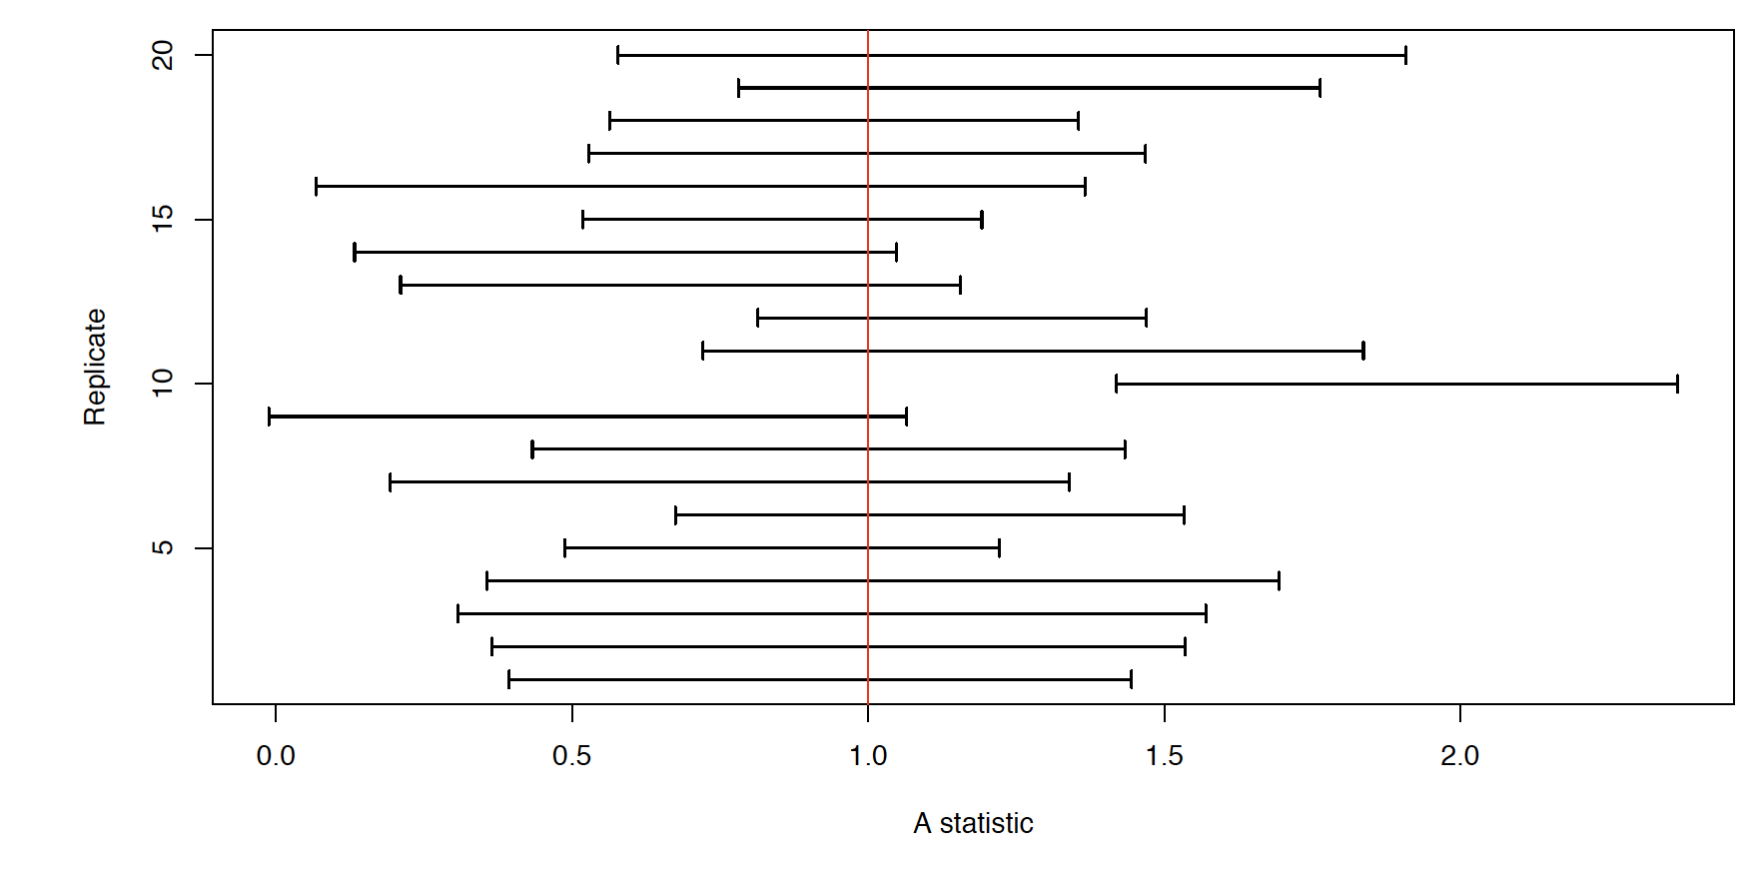
Confidence intervals
Notes:
This was presented last week. Statistic on the x axis (here it would be our lambda) and repeated sample on the y axis. The horizontal bars are the confidence intervals and the red line is the true population statistic. Can see that not all confidence intervals include the truth.

Slide 52
Confidence intervals
Confidence interval is used to indicate values for the true parameter that are more likely, given our data
IF you repeated your sampling many times and each time drew a confidence interval – 95% of the time (on average) the confidence interval would contain the true parameter value
Notes:
Definition =

Slide 53
Confidence intervals
Confidence interval is used to indicate values for the true parameter that are more likely, given our data
IF you repeated your sampling many times and each time drew a confidence interval – 95% of the time (on average) the confidence interval would contain the true parameter value FREQUENTIST IDEA
Notes:
Definition = on slide

Slide 54
Model
Data
Parameter estimation
Uncertainty
Notes:
Finish off with the link between uncertainty and data

Slide 55
Uncertainty
Notes:
This is the confidence interval for our data

Slide 56
Sample size and uncertainty
Less data = higher uncertainty in our estimates
Notes:
This is the confidence interval for our data

Slide 57
Interpretation
Meaning depends on the data and question
Notes:
How you interpret the results of maximum likelihood parameter estimation depends on your data and question

Slide 58
Interpretation
Meaning depends on the data and question:
E.g. MLE of 50 lions and confidence interval of 49 to 52
= very good estimate in terms of uncertainty (only 3 lions variation)
But
= useless if you need to be sure you capture all lions in an area, one lion still free could be too many
Notes:
How you interpret the results of maximum likelihood parameter estimation depends on your data and question

Slide 59
Summary
Model
Data
Parameter estimation
Uncertainty
Notes:
Summarise the lecture on the schematic

Slide 60
Summary
Population and sample
Model
Data
Parameter estimation
Uncertainty
Notes:
Summarise the lecture on the schematic

Slide 61
Summary
Match to data and question
Population and sample
Model
Data
Parameter estimation
Uncertainty
Notes:
Summarise the lecture on the schematic

Slide 62
Summary
Match to data and question
Need to represent whole distribution of parameter – use likelihood
Population and sample
Model
Data
Parameter estimation
Uncertainty
Notes:
Summarise the lecture on the schematic

Slide 63
Summary
Match to data and question
Need to represent whole distribution of parameter – use likelihood
Population and sample
Model
Data
Parameter estimation
Impacted by everything! Quantify with confidence intervals from parameter distribution (likelihood curve)
Uncertainty
Notes:
Summarise the lecture on the schematic

Slide 64
Summary
Match to data and question
Need to represent whole distribution of parameter – use likelihood
Population and sample
Model
Data
Parameter estimation
Impacted by everything! Quantify with confidence intervals from parameter distribution (likelihood curve)
Uncertainty
Interpret based on question and data
Notes:
Summarise the lecture on the schematic

Slide 65
EXERCISE TASK
On your table write in your own words:
“What maximum likelihood estimation is and why we use it in statistical modelling”
ASK any questions!!!

